Slide 1


Stock Market Analysis & Prediction
For visualization based on time duration.
With Python & Power BI Comparison

Slide 2


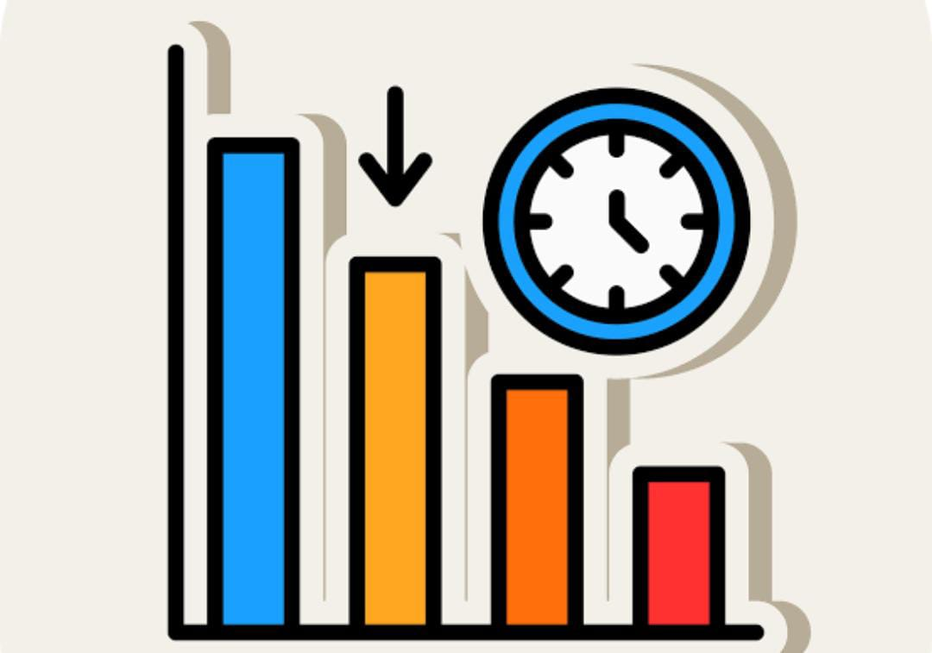



Content of Project Overview
TIMELINE
Provide a high-level timeline for the analysis. This could include deadlines for data collection, interim reports, and final recommendations
Objectives
market trends, identifying undervalued stocks, or assessing portfolio performance
Stock Market Analysis & Prediction
Scope
This could include the types of stocks being analyzed (e.g., large-cap, mid-cap), geographic regions, or sectors (e.g., technology, healthcare).
Deliverables
This might include a report on market trends, a list of recommended stocks, or a risk assessment of the current portfolio
Risk & Mitigation
Identify potential risks that could impact the stock market or the analysis and propose strategies to mitigate these risks.

Slide 3
Data Discription
Date :- shows the time duration, number of years of data.
High :- maximum or highest price of stock of a particular company
Low :- minimum or highest price of stock of a particular company
Open :- price of stock when the selling of stock were started or starting price of stock.
Close :- price of stock when the selling of stock were ending or ending price of stock.
name:- name of the particular company who stock were selling.

Slide 4

Problem Statement
This project focuses on analyzing the historical behavior of stocks and leveraging predictive Assess the correlation between the prices of various stocks. This helps to understand how the movements of different stocks are related to each othermodels to forecast future stock prices. The main objectives are as follows:
Change in Stock Price Over Time: Analyze how the price of a stock has fluctuated over a specified period. This involves tracking the historical data of stock prices and determining the percentage change between different time points
Open to Close Price Change : refers to the difference between the price of a stock (or any financial instrument) at the time the market opens and the price at which it closes on the same trading day. This metric is a key indicator of intraday performance and can provide insights into the daily sentiment and trading activity surrounding a particular stock or market as a whole.

Slide 5
Highest Price Changing companies : refer to stocks or companies that experience the most significant changes in their stock prices during a specific period, typically measured over a trading day, week, or month. These companies are often the focus of traders, investors, and market analysts due to their potential for high returns (or losses) within a short time frame
Stock Performance Comparision:compare the performance of different stock based on there average closing price over a specific period.
Assessing the Risk of Stock Decline Based on Low Price Analysis: The low price of a stock during a trading session can indicate strong selling pressure and potential downward momentum. However, it can also present a buying opportunity if the stock is perceived as undervalued. Understanding the implications of low price movements is critical for risk management and identifying potential entry points.

Slide 6

DATASET :- Dataset is available in the given link . you can download it at your convenience.
(FROM:- Kaggle).stock_raw_data.csv

Slide 7

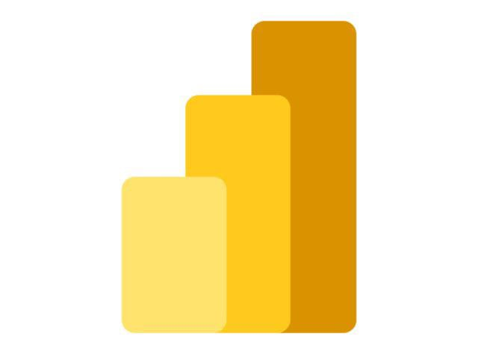
Pre-Processing / Data Cleaning
python
power-bi
Importing Data :-
Count Values :-
Detect / Handling Null / Missing values :-
Importing Data :-
Count Values :-
Detect / Handling Null / Missing values :-

Slide 8

Visualization in Power-BI
QUESTION :- 1 What was the change in price of the stock over time?
Through Power Pivot , Calculation is done:-
Stock {close} - Stock {open} = Stock change in price by over time
Visualization :- Line chart is used
X-axis - year (Time Period)
Y- axis - sum of stock by over time ( yearly)

Slide 9

Visualization in Power-BI
QUESTION :- 2 Open to Close Price Change
Through Power Pivot , Calculation is done:-
Stock {close} - Stock {open} /Stock {open}*100 = price change in %
Visualization :- matrix chart is used
No. of fields are as follow :-
1) year
2) closing price of stock
3) opening price of stock
4) price change in percentage
5) company name

Slide 10

Visualization in Power-BI
QUESTION :- 3 Highest Price Changing companies :
Through Power Pivot , Calculation is done:-
Stock {close} - Stock {open} /Stock {open}*100 = price change in %
Visualization :- bar chart is used
X-axis -company name
Y- axis - sum of price change
For visualization based on time duration.
we add slicer based on yearly , monthly and daily
and on the based on quarterly basis.

Slide 11

Pre- Processing through python
read csv file of given data
counting of given data
basic statistics for numerical column
sum of missing value and handling it of given data
mean and median of high and low price
handling missing values
normalization of high and low prices of stock
handling outliners

